Slide 1


FINAL PROJECT REVIEW 01-04-2021 “Low Cost Application Motion Hand Gesture Controller Using Adaptable Sensors”
PANIMALAR ENGINEERING COLLEGE
Presented By
Gadikota Bramha Theja [ REGNO:211417104064]
Dept of CSE
Bush Ashwin RM[REGNO:211417104088]
Dept of CSE
Guided By
Mr.C.Tyagarajan
Associate Professor
Dept of CSE

Slide 2
CONTENTS
Abstract
Introduction
Motivation
Circuit diagram
Basic layout
Hardware and software component
Implementation
Output
Screenshot
Future development
Reference
Conclusion

Slide 3
ABSTRACT
Today we are surrounded by innovative technology and it is evolving day by day
Among these technologies, the hand gesture is one of such techniques that helps humans to interact with the computer and control its functions using some pre-defined gestures
Usage of hand gesture technology eliminates the use of hardware we use traditionally such as mouse and keyboard as our interaction with the computer is going to be contactless making it a more affordable approach
This technology uses ultrasonic sensors that work on the principle of ultrasonic waves produced by the gesture making the interaction process faster
This technology is thus time-saving, cost-effective, and efficient. The hardware requirement of this technology consists of Arduino UNO board, low in cost sensors, and a personal computer making it highly affordable
This technology not only brings advancement human-computer interaction but also speeds up the process, making it a productive approach to choose

Slide 4
INTRODUCTION
In this world, between technologies like automation, artificial intelligence, data analytics, etc., the use of gesture-controlled computers and laptops is getting very famous
In this technique, one can control the functions of their computers or laptops by only a wave of their hand
This technology is called leap motion. It may sound simple and interesting, but the system used in this technology is not very affordable
The proposed model uses the power of Arduino and Python which not only makes it a cheaper and affordable approach to leap motion, but it is also easier to build
In this model, we can control a media player (VLC) based on the gesture type and the position of our hands

Slide 5
MOTIVATION
Automation of the existing technology is my motive in this project.
This project is not only advanced but also cost-effective when compared to the traditional approach.
With very low-cost IoT devices we can achieve this technique.
If we will buy a laptop with leap motion technology or gesture deduction technology it will cost us a huge amount of money as these devices are very costly.
So with this approach we can make our own gesture control laptop or system at a very low cost.

Slide 6
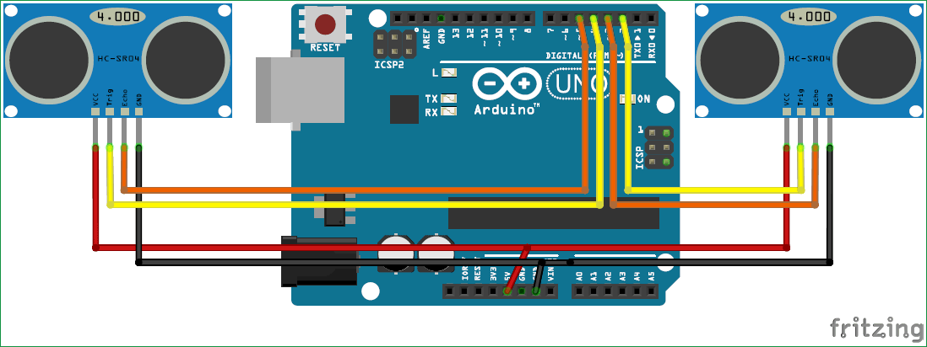
CIRCUIT DIAGRAM

Slide 7
Basic Layout
Python, pyautogui library
(To perform action)
Ultrasonic Sensor
(HC-SR04)
Arduino,Python
Ultrasonic Sensor
(HC-SR04)
Hand Gesture
Arduino UNO R3
System
Ultrasonic Sensor
(HC-SR04)
Application Control-
Switch between tab
Video play/pause
Volume increase/decrease
Scroll up, scroll down
Image slide
Hand Distance sensor

Slide 8
Hardware components : 1. Arduino 2. Two Ultrasonic Sensors (HC-SR04) 3. Some wires
HARDWARE AND SOFTWARE COMPONENTS
Software component :
1. Arduino IDE
2. Python IDLE
3. PySerial library (We will use to communicate with serial ports).
4. PyAutogui library (We will use to perform actions).

Slide 9
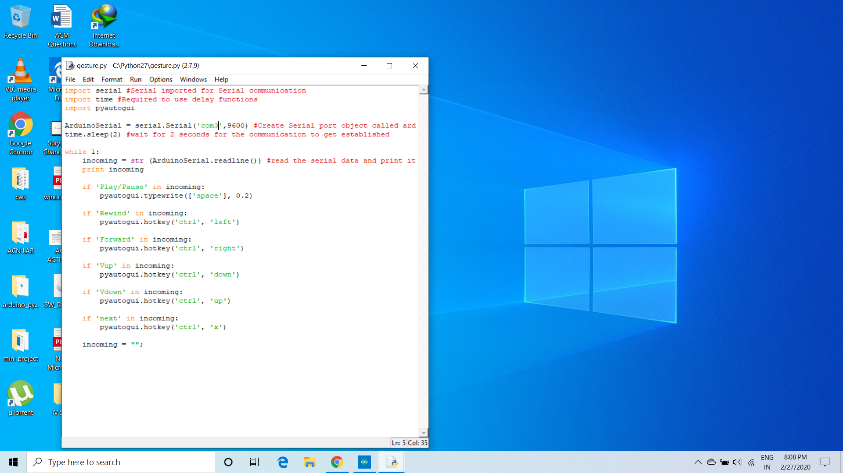
IMPLEMENTATION
Install python :-

Slide 10
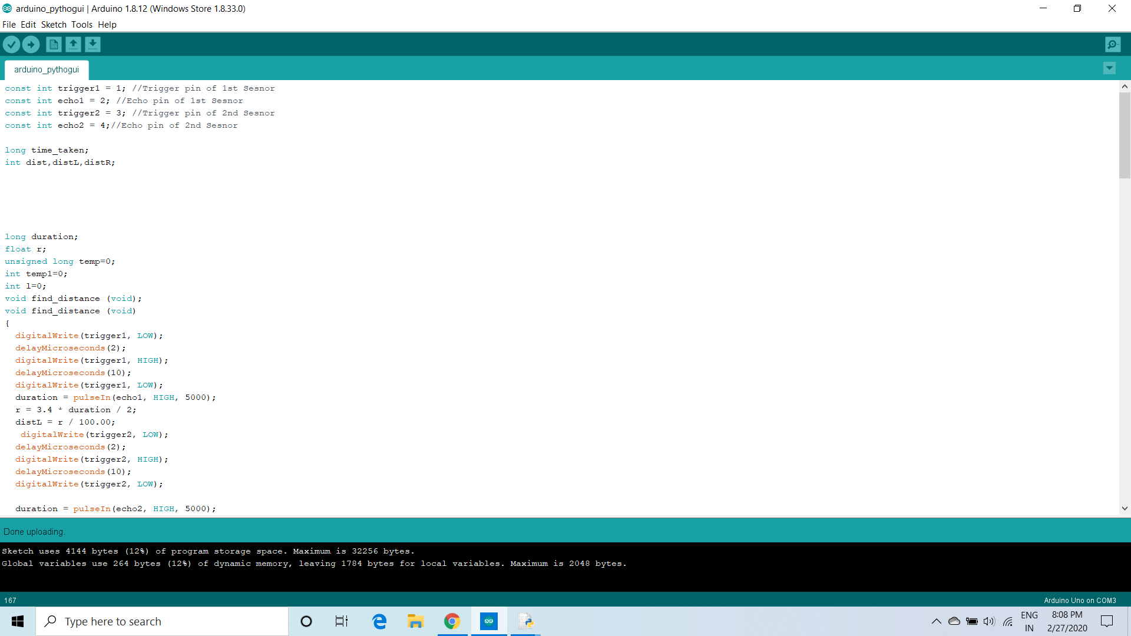
Install Arduino :-

Slide 11
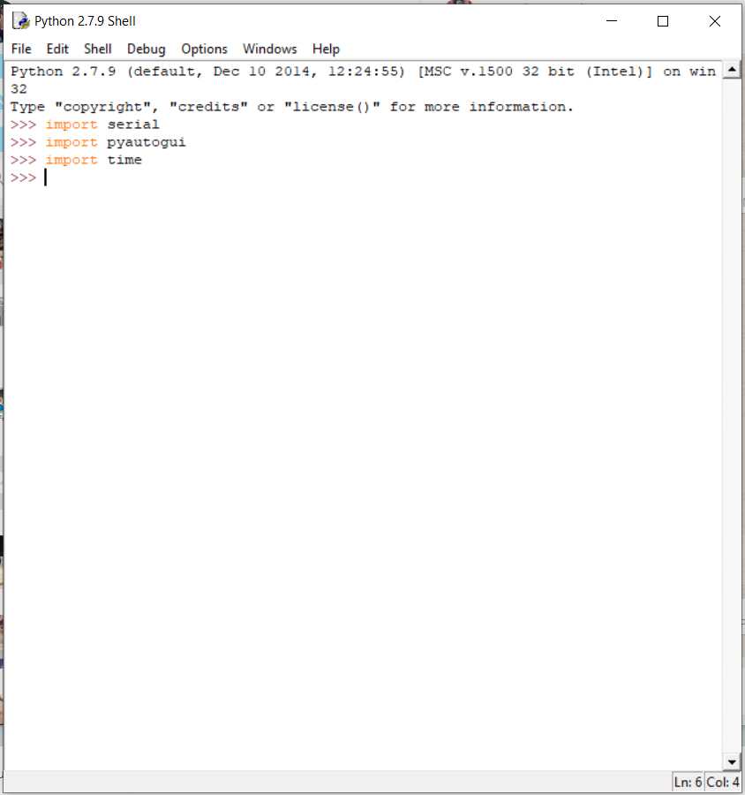
Install the following library and check whether its working or not :-

Slide 12
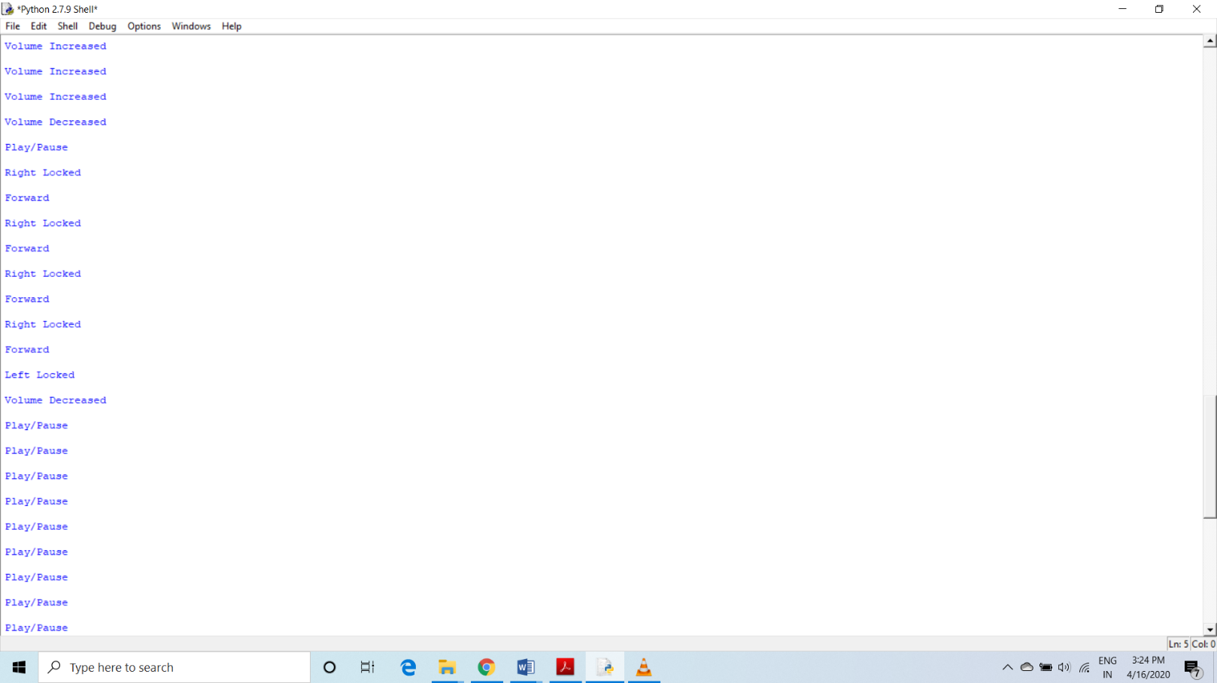
OUTPUTS

Slide 13
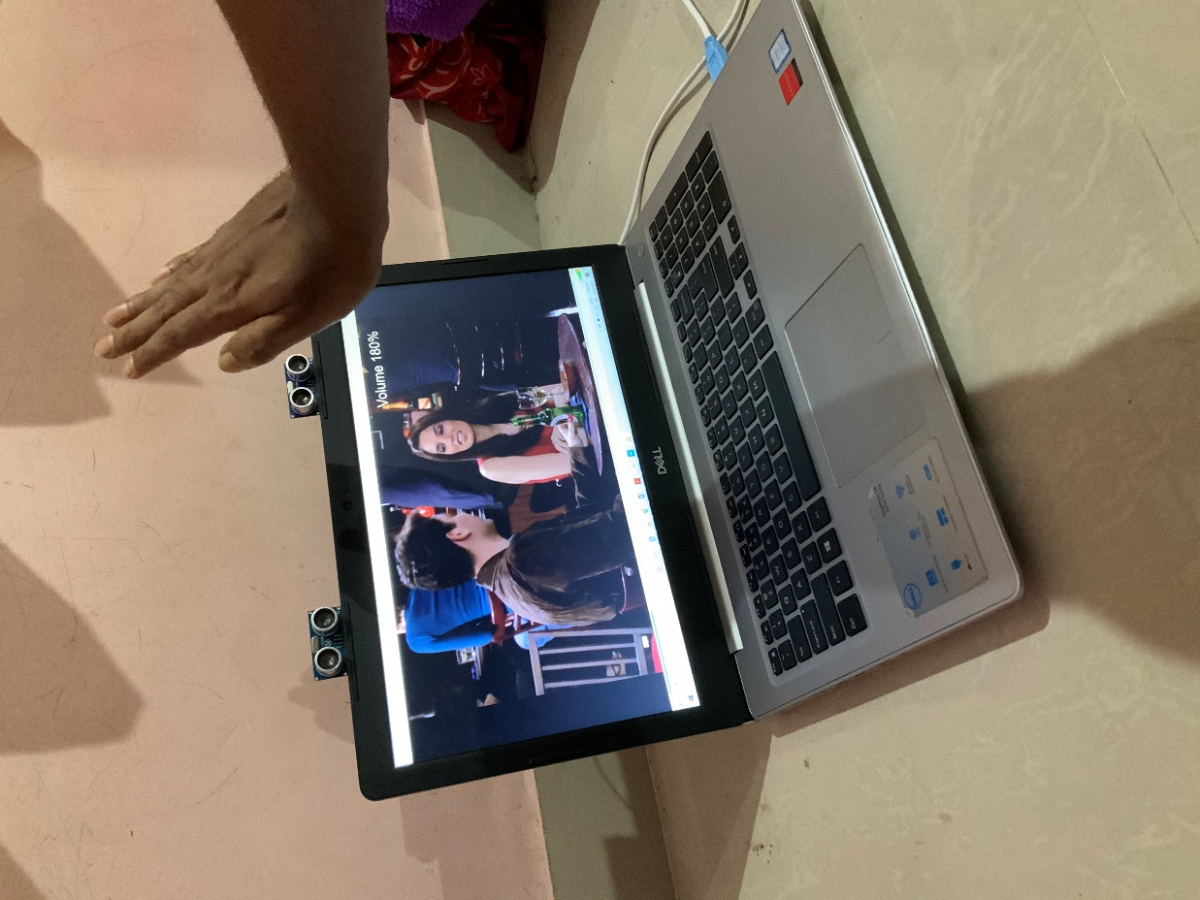
Volume up

Slide 14
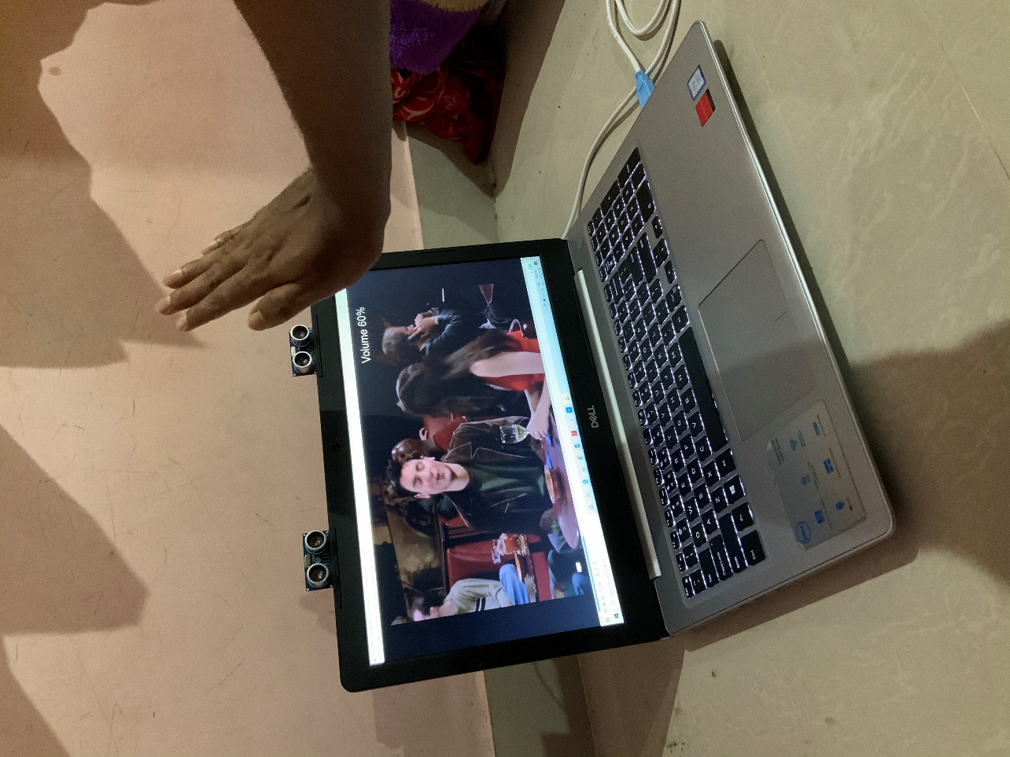
Volume down

Slide 15
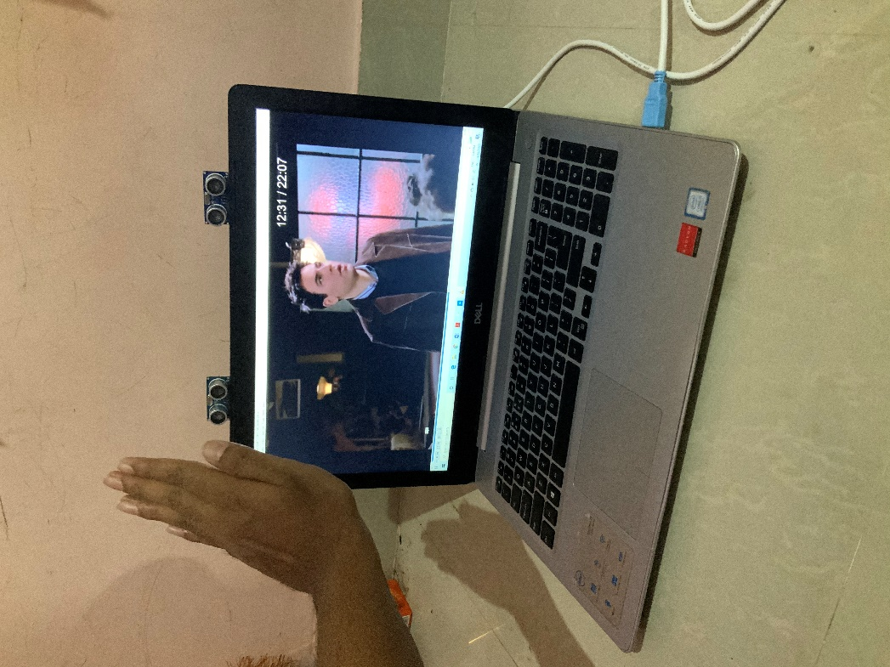
Forward

Slide 16
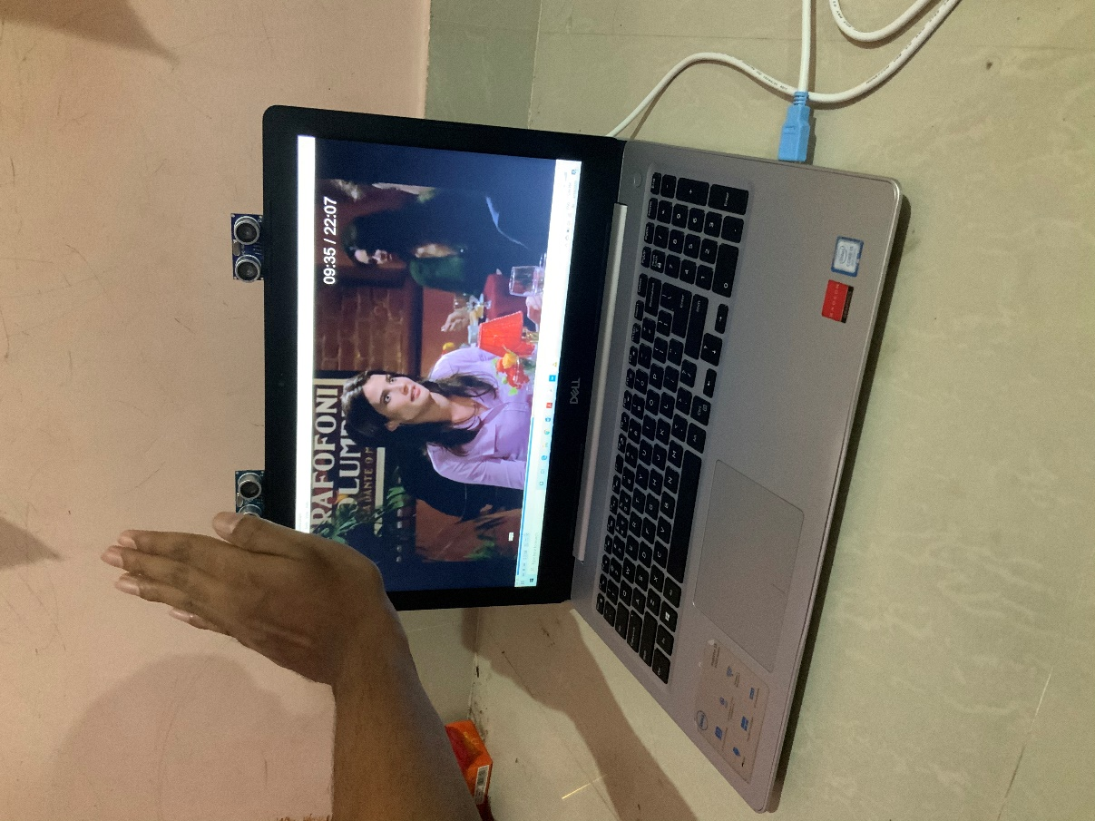
Backward

Slide 17
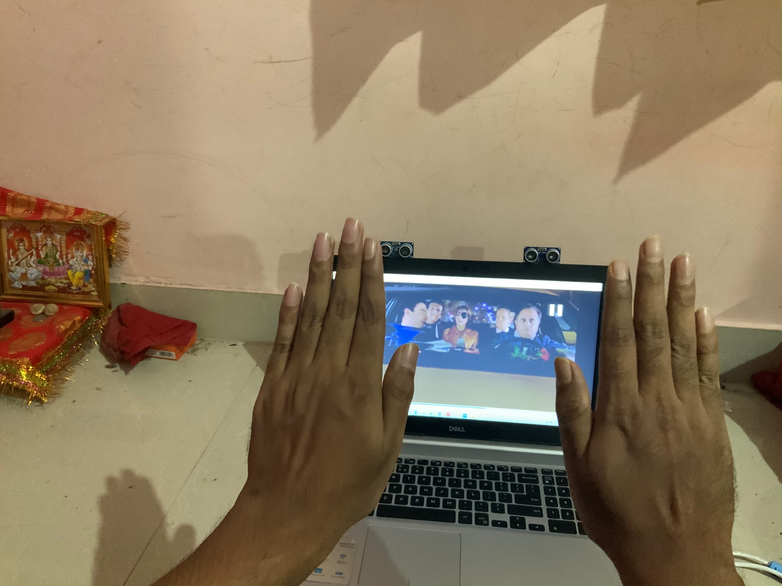
Play

Slide 18
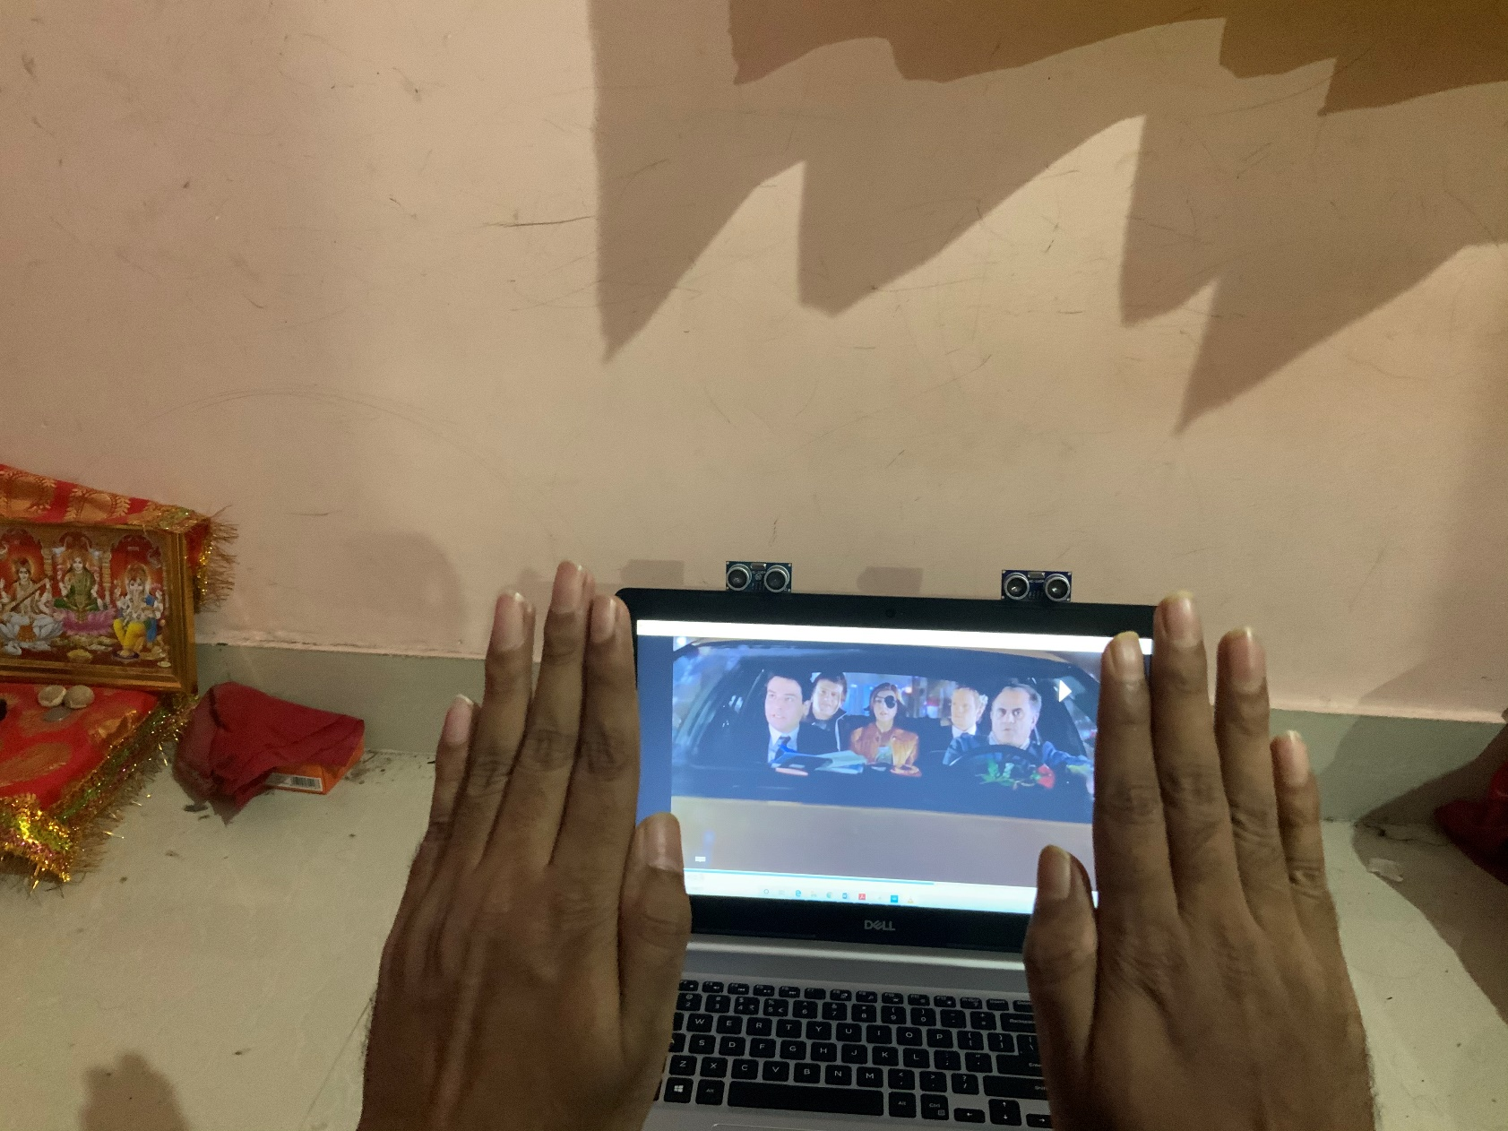
Pause

Slide 19
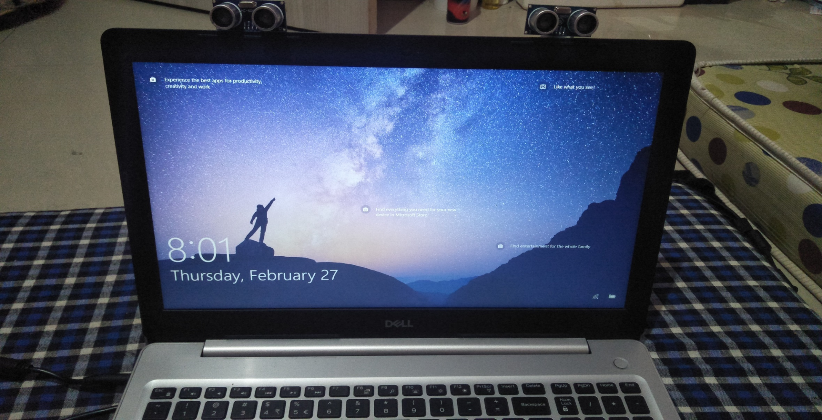
SCREENSHOTS

Slide 20
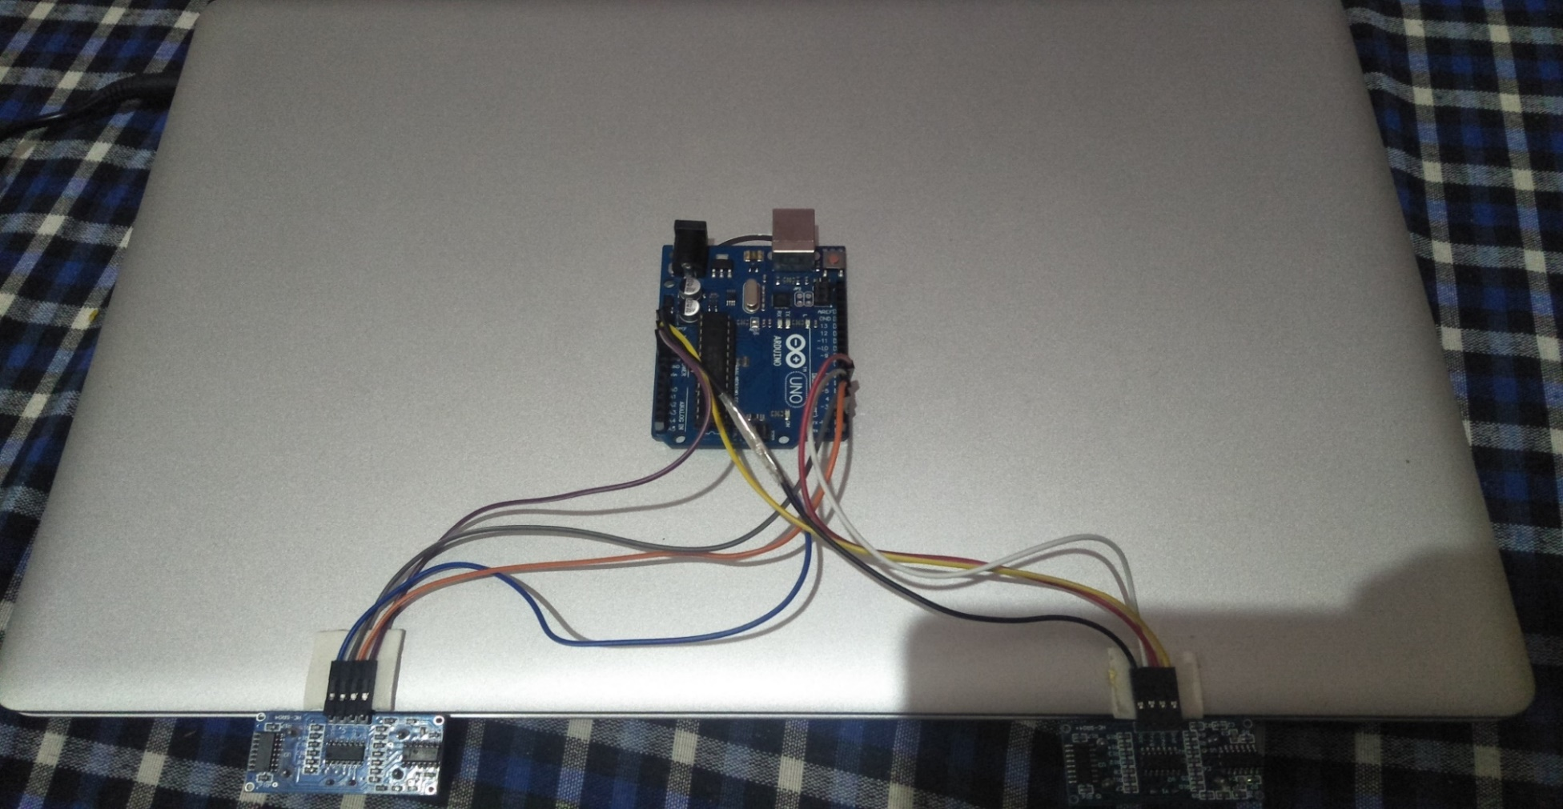

Slide 21
FUTURE DEVELOPMENT
This project can be further implemented on many other gesture controls machines
We can control many applications with this by just changing some of the codes
We can integrate this type of module for many applications like browsers, designing and editing applications, gaming, etc.
The knowledge is ever-expanding and so are the problems that mankind strives to solve.

Slide 22
REFERENCES
[1] Author: Rohit Mukherjee1, Pradeep Swethen2, Ruman Pasha3, Sachin Singh Rawat4
HAND GESTURE CONTROLLED LAPTOP USING ARDUINO
[2] Author: G. Anil Kumar1, B. Sathwik2
GESTURE CONTROLLED VIDEO PLAYBACK
[3] Author: Mayuri S. Khasale
COMPUTER CONTROL WITH HAND GESTURES USING ULTRASONIC SENSORS
[4] Author: Surya Mishra1, T. Dhikhi2
GESTURE CONTROL KEYBOARD

Slide 23
CONCLUSION
The gesture control system uses two ultrasonic sensors, Arduino UNO, and a system to carry the operation of video player controller. Its main motive is to reduce the effort of interacting with the system with the input devices and using simple hand gestures instead of that. It increases interactivity with computers. This type of technology can be used in giving presentations, classrooms for easier and interactive learning, gaming, etc. with this kind of techniques, we can also make other gesture reorganization system like opening taps without touching it only waving hand in front of it to open it, using hand wash without touching it by hand gesture and many more.

Slide 24
THANKYOU

